Slide 1
Sajib Kumar Dhali
RC Cars Presentation

Slide 2
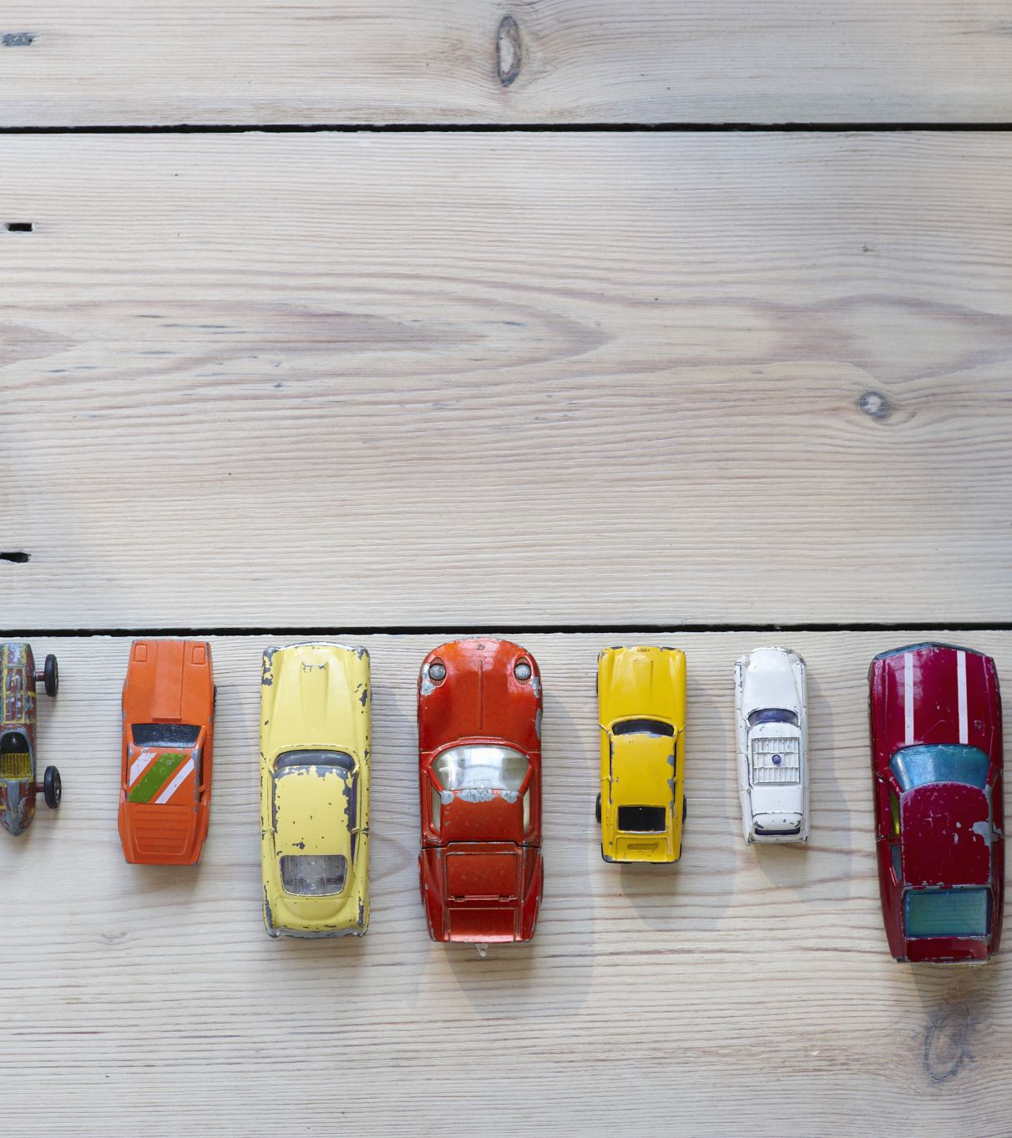
RC CAR HISTORY AND RATIONALE
First remote-controlled car ever created was the nitro-powered Ferrari 250LM.
The 70s saw the emergence of 1/8th scale nitro powered RC cars.
Very first RC vehicle, aptly called RC1 in 1971.
It was a 1/8 scale nitro-powered on-road pan car. Four years later, the company produced the next model, also a 1/8 scale nitro car, called RC100.
RC12E electric pan car in 1978
1979, Tamiya introduced off-road buggy cars to the hobby.

Slide 3
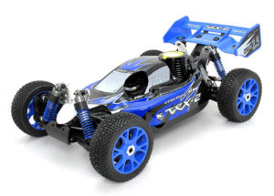
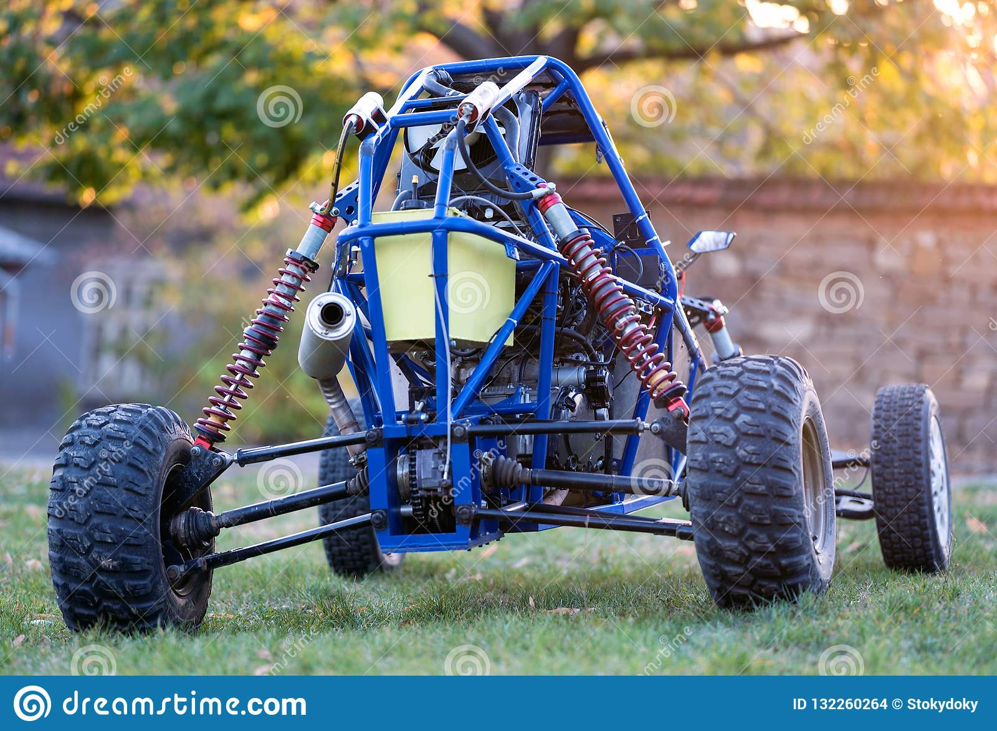
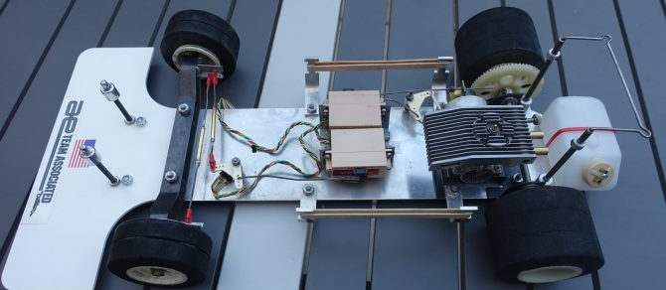
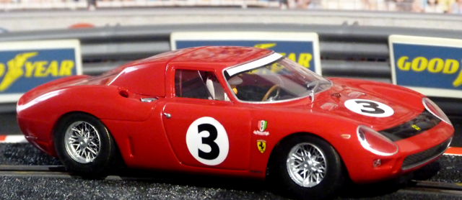
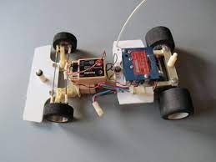

Slide 4
80S
Era where RC cars moved its paradigm from simply scale models to high-performance models.
Produced its award-winning buggy model, RC10 in 1984.
High- Grade car that featured aircraft-grade aluminum alloy body chassis. It also contained a transmission with adjustable ball differential that allowed the car to tune to any track conditions.
In 1985, Tamiya introduced a 4WD buggy called the HotShot.
Model was designed to survive slippery and dusty surfaces and claimed to be faster than its 2WD models.
Year of 1988 witnessed the popularity burst of 4WD off-road RC cars.
In 1989, Team Associated heated up the Associated-Losi rivalry by introducing another great car, the RC10L pan car.

Slide 5
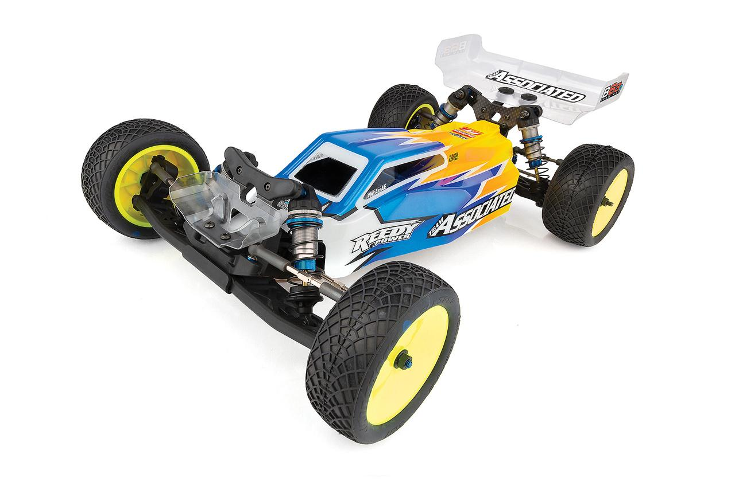
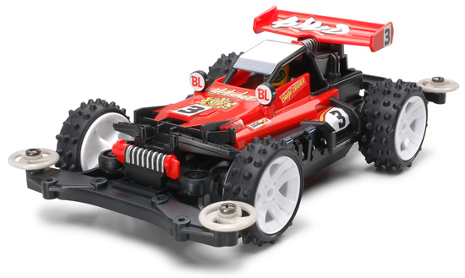

Slide 6
90S
In 1994, Team Associated released its 1/10 scale gas truck called RC10GT.
HPI entered the RC market by releasing their very first vehicle called the Super F1.
Traxxas also introduced its 2WD electric monster truck and stadium truck known as the Stampede and the Rustler.
Size of the cars also began to get smaller during this time – from 1/10-scale to 1/12 and eventually to 1/18.
Gas-powered cars became a hit.

Slide 7
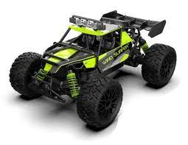
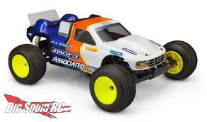

Slide 8
20S
The 2000s was the era of rock crawlers and short course trucks.
Hobby witnessed a change in its radio system technology, from AM/FM to 2.4GHz. During this decade, RC manufacturers have started to use the 2.4GHz modules on their transmitter.
In 2004, the followers of the hobby shifted their attention to rock crawler models.

Slide 9
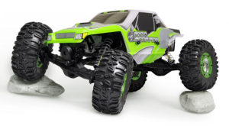

Slide 10
Objectives
To construct and test the Transmitter circuit with DIP/Tact switches
To construct and test the Receiver circuit with DIP LEDs.
To construct and test Relay circuit.
To test the full function of RC car.
To present the RC car project

Slide 11
Explanation And Description
 | Description | Quality
Transmitter with DIP/Tact switch | Vero Board (size 60 mm x 60 mm) | 1
 | Transceiver module - Bravo T868 | 1
 | Resistors, 10k ohm | 8
 | DIP Switch (8 ways) | 1
 | Tactile Switch | 4
 | 18 pin Female SIL, Right-Angle Long Body turns pins socket | 1

Slide 12
 | Description | Quality
Receiver with DIP LEDs | Vero Board (size 60 mm x 60 mm) | 1
 | Transceiver module - Bravo T868 | 1
 | Resistors, 180 ohm | 8
 | DIP LEDs (8 arrays) | 1
 | 18 pin Female SIL, Right-Angle Long Body turns pins socket | 1
 | Female SIL header (5 pins) | 1

Slide 13
 | Description | Quality
Receiver With Relay Driver | Vero Board (size 60 mm x 60 mm) | 1
 | Diode – IN4001 | 4
 | IC ULN 2003A | 1
 | 16 pins IC holder | 1
 | Female SIL header (5 pins) | 1
 | Relay (DPDT, 5V) | 2
 | 2 pin type – SIL female header | 2
 | 8 pins IC holder for Relay | 2
 | DC motor, 5V | 2

Slide 14
Requirements And Specifications

Slide 15
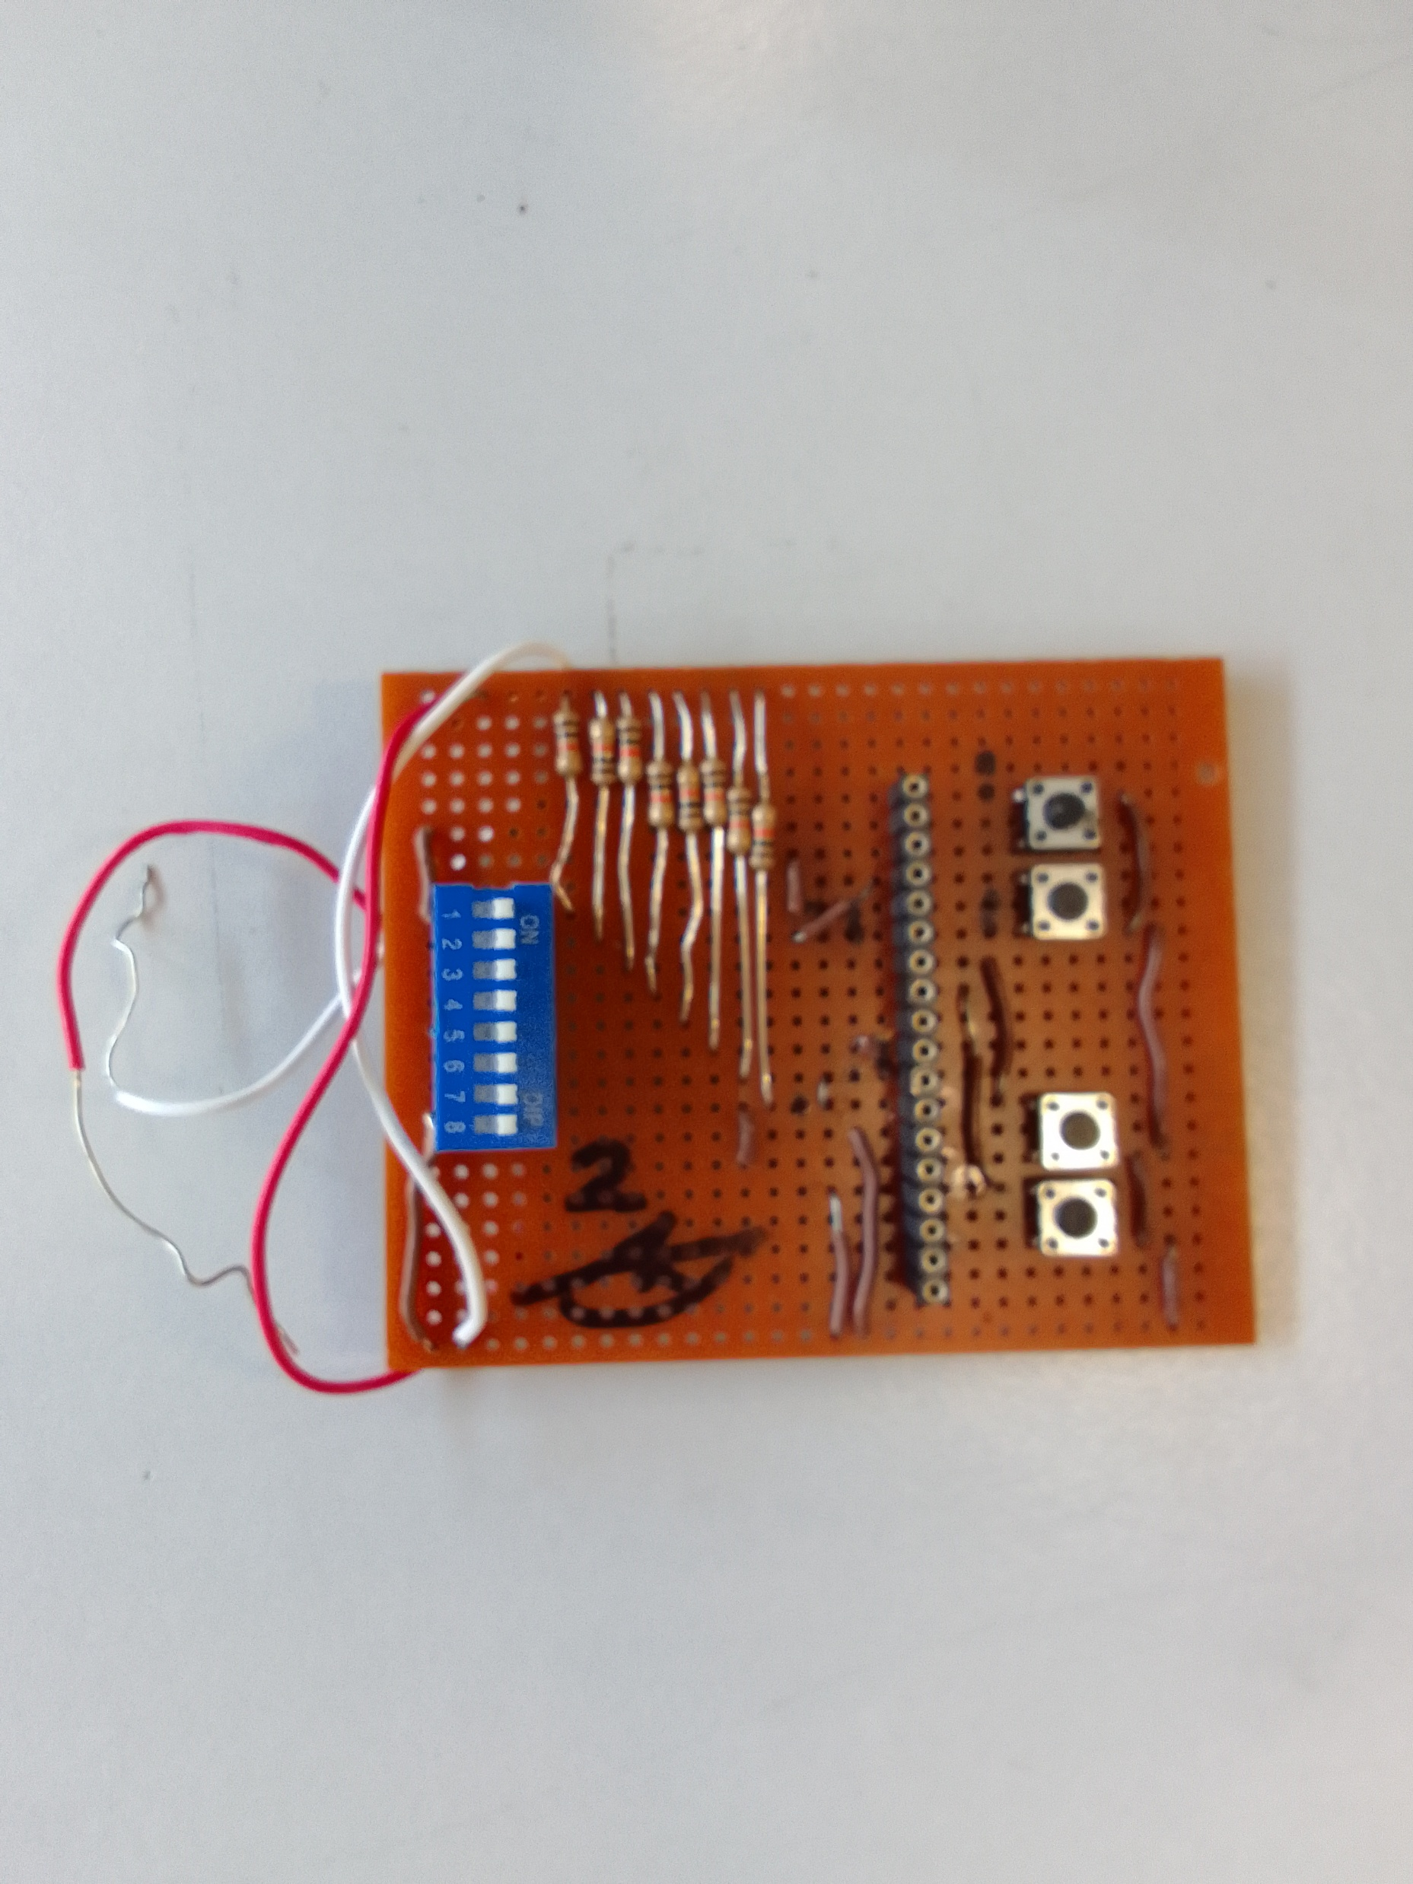
Planning And Schedule
( Transmitter ) 20 April – 21 April

Slide 16
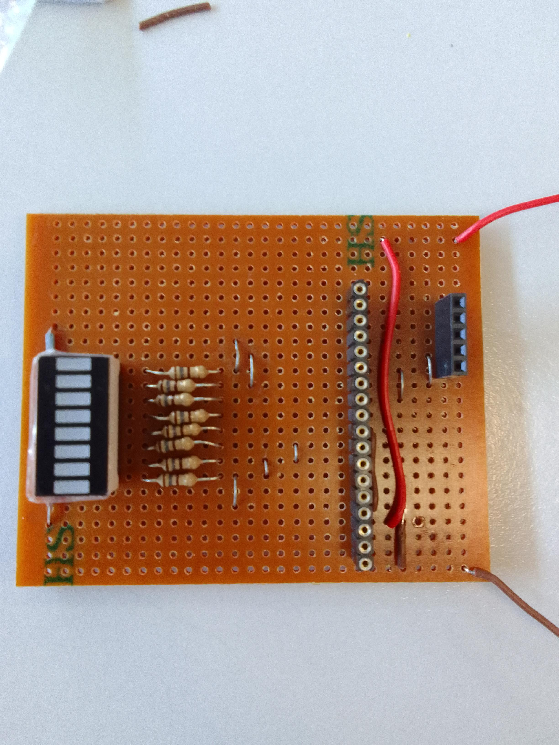
( Receiver with leds ) 25 April – 26 April

Slide 17
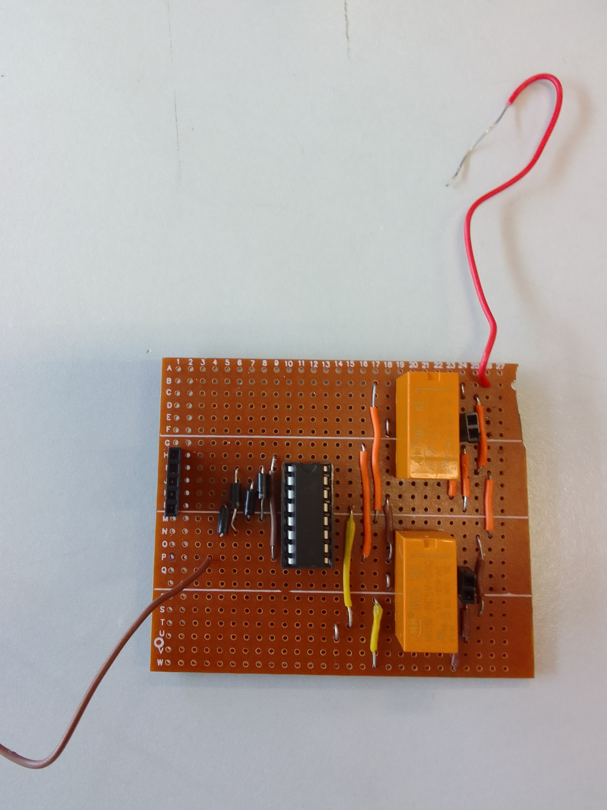
( Receiver with relax driver ) 27 April – 5 May

Slide 18
Discussion

Slide 19
Recommendation

